Slide 1
Configuring and Extending SharePoint 2007 Search
Making Your Content Searchable

Slide 2
Agenda
MOSS Search Architecture
Configuring content sources
Creating search scopes
Using Search Center
Creating custom search pages

Slide 3
WSS Verses Office Server Search
Windows SharePoint Services (WSS 3.0)
WSS search is a subset of MOSS search feature
Eases transition from WSS to MOSS
Indexing and query always on the same machine
Search over site content only
Microsoft Office SharePoint Server (MOSS)
Adds new search functionality over base WSS search
Indexer and query can be separated on different machines
Multiple catalog supported per indexer and query servers
Aggregated content - local + external
Notes:
Instructor Notes
WSS Search
One of the key investments this release is WSS (v3) will be using the same search technology as in MOSS as opposed to WSS(v2) that used sql full text search.
The WSS search functionality is a subset of MOSS search functionality
This adds ease of transition when you want to move from a WSS installation to a OSS installation.
Only local content gets indexed and search is available at the individual site scope.
MOSS Search
MOSS search has more enhanced functionality than WSS – richer search results UI and customization control, crawls of local and external content supported and management of search configuration.
One important thing to note is the topological concepts are same across WSS and MOSS with certain differences based on the usage patterns of the portals/sites

Slide 4
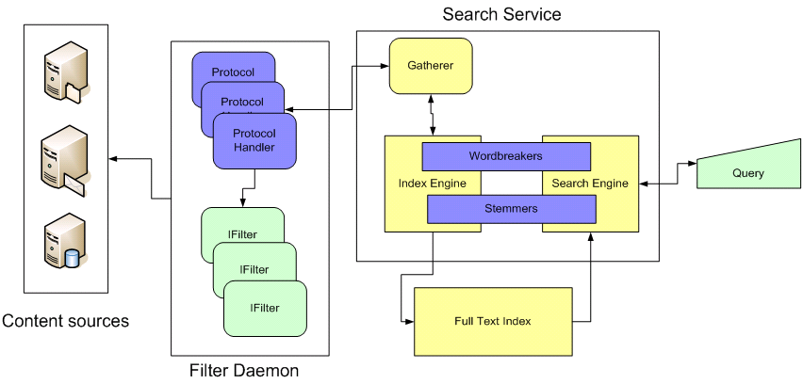
Search Architecture and Terminology
Key pieces to search infrastructure
The Gatherer
Content sources, protocol handlers and IFilters
Index Files
Notes:
Search Architecture Terminology:
Content source: This is the place where the content lives. A content source can be a WSS site or a Window File Share.
Protocol Handler: This is the code that allows the WSS/MOSS index service to reach across the network and retrieve the content to be indexed.
IFilter: A COM-based DLL able to parse a file and convert it into a UNICODE character array. You must have a IFilter for each type of file you want to search through. For example, Microsoft provides IFilters for Office documents and Adobe provides an IFilter for PDF files.
Gather: This is the main component responsible for retrieving content and moving it through the process to build indexes.
Workbreaker: Language-specific component that tokenizes text into words.
Stemmer: Language-specific component that find derivations of a word. For example, the stemmer will determine that running, runs and ran are all derivations of the word run that should be incorporated in search results.

Slide 5
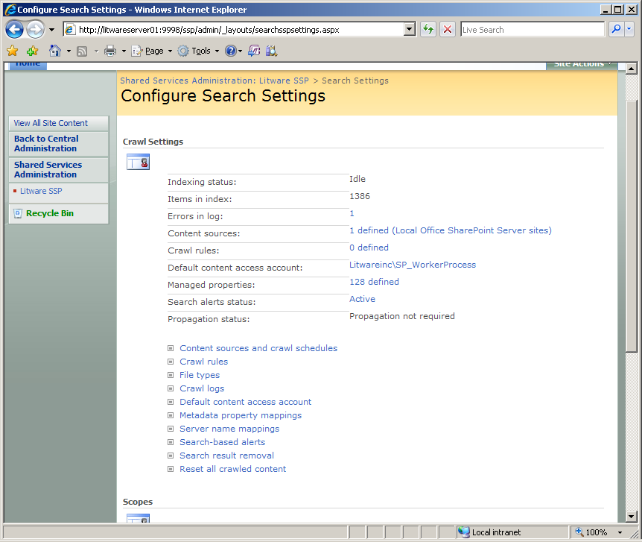
Configuring Search

Slide 6
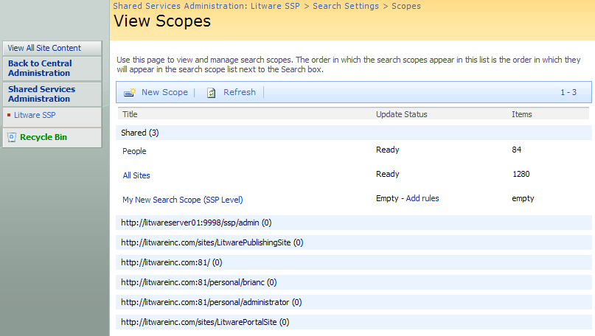
Search Scopes
Created at one of two different levels
Can be created within content of an SSP
Can be created within context of a site collection
Notes:
Search Scopes allow you to narrow down the area in which the user will search. For example, a commonly searched site is the HR site, if a user knows the document they are looking for is on the HR site, it will be easier and more efficient to just search the HR site. As a site collection administrator you can determine, with in your site collection what scopes are appropriate.

Slide 7
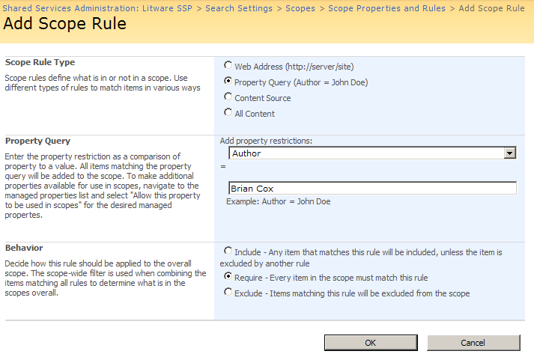
Adding Rules to a Search Scope
Each search scope has one or more rules
Rules define criteria to include/exclude content
Notes:
Scopes are configured using rules. These rules define what is being searched and how this scope will be utilized. For example, there may be a time when a site is determined not to have relevant information. As the site collection administrator, you could create a scope with a rule excluding that site from the search results.

Slide 8
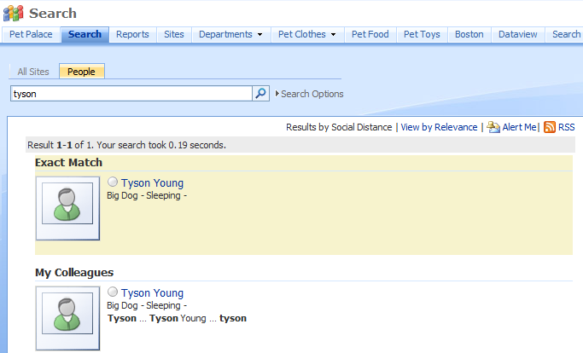
People Search

Slide 9
Search Center
Customize and extend Search Center
Modify query parameters
Add tabs
Modify XSLT, CSS on results
Custom search Web Parts

Slide 10
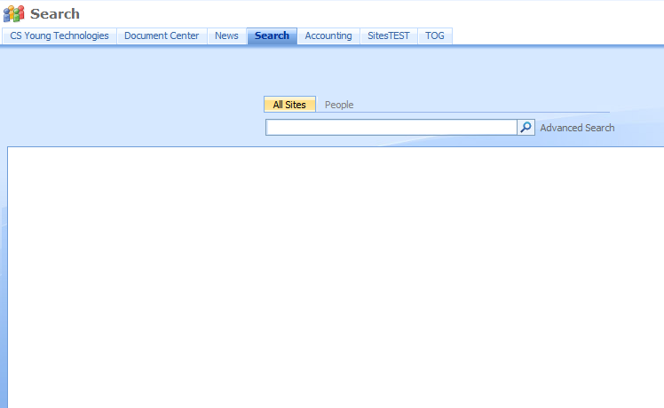
Search Center and Search Pages
Notes:
The search center allows you to customize the search experience. Tabs can be added for different scopes and pages can be created for each tab. This will allow you to determine how the search results will be presented.
Need to customize more?
Use XSLT and CSS to transform search results
Write code against Object Model or Web Services
Look to 3rd party
http://www.codeplex.com/FacetedSearch
Free Community Tool
http://www.ontolica.com/
Free Wild Card search/Pay full product
http://www.coveo.com
Replaces SharePoint Search Engine
http://www.ba-insight.net
Hit Highlighting, preview

Slide 11
Search Web Parts
9 OOB web parts including
Search Box
Core Results
High Confidence
Statistics
Pagination
Action Links
Matching Keywords and Best Bets
Search Summary (Did you mean?)
Advanced Search
Notes:
These web parts allow you to create customized search pages for your users. You can also use them to create a static search page. It is typical to get a request to see the last ten modified documents, search will allow you to do this.
5/24/2009 6:50 AM
© 2006 Microsoft Corporation. All rights reserved.
This presentation is for informational purposes only. Microsoft makes no warranties, express or implied, in this summary.
11

Slide 12
Search Features
Duplicate Collapsing
Synonyms
Hit Highlighting
Did You Mean?

Slide 13
Possible customizations
Customize Thesaurus
Located at drive:\Program Files\Microsoft Office Servers\12.0\Data\Config
Replacement or Expansion sets
Eg. Replace “Weirdo” with “Eccentric”
Substitution weighs and stemming is supported
Noise Words

Slide 14
Keyword/Best bets
Highly under utilized
Keyword is what your user is searching for
Can assign a definition to display
Best bet is what you think they want
Links to any web url
Administered by site collection admin
Notes:
For example, a commonly searched for item on many organizations’ portals may be the holiday schedule. When a user goes to search for holiday schedule, first of all there many terms a user may search for: paid holidays, paid time off, vacation days, scheduling, etc. Many of these terms many not return the correct result at all, or for a couple of the terms, the desired result may be far down on the list of return results. By creating a keyword and best bet, you can include synonyms, provide a short definition of the term, Holiday Schedule, and provide a link to the holiday schedule. This does two things, speeds up the users productivity by not wasting time searching, and improves their confidence in SharePoint.

Slide 15
Search Reporting
Available from the SSP
Two types of reports
Search queries
Search results
Great feature for understanding your environment
Notes:
After the portal has been in production for awhile, the search reports will help you to constantly improve the user experience. You might notice users are constantly searching for “sales figures” and not returning any results or not clicking on any of the results that are presented. You could talk to the sales team and find out what someone might be trying to find when they are searching for “sales figures” and create a keyword and best bet.

Slide 16
Agenda
MOSS Search Architecture
Configuring content sources
Creating search scopes
Using Search Center
Creating custom search pages

